Slide 1

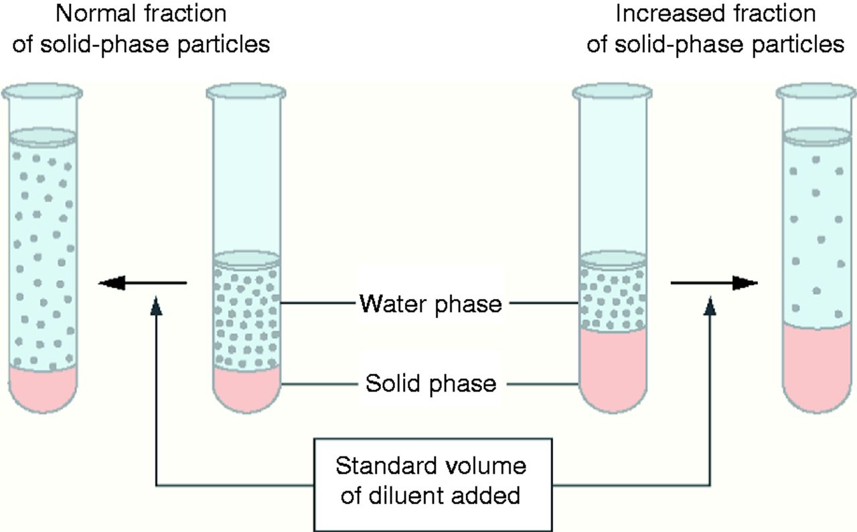
Pseudohyponatremia Causing a Fatal Outcome in a Patient with Familial Hypertriglyceridemia
Amanda Dawson, MD; Palak Patel, DO; Anna Dedona, DO; Srinivas Kata, MBBS ; Premal Patel, MD; Pramil Cheriyath, MD
Department of Internal Medicine, Hackensack Meridian Health-Ocean Medical Center, Brick, NJ
Learning Objectives
To get an understanding of the false decrease in sodium levels in conditions such as hyperlipidemia and hyperproteinemia.
To discuss the importance of measuring true sodium levels in these patients.
Imaging
CT scan of the abdomen and pelvis:
Severe acute pancreatitis with diffuse pancreatic enlargement showing inflammatory changes and free fluid.
Hospital Course
Because the patient's repeated lab values revealed critically low sodium levels (109 meq/L), he was started on 3% saline at a rate of 25 ml/hour for the next 8 hours with frequent electrolyte monitoring.
The next day, the patient had a cardiac arrest; Return of spontaneous circulation was achieved within ten minutes.
He was intubated and placed on ventilator support.
His arterial blood gas showed a P^{H} of 7.09, Pco₂ of 36.2, Po₂ of 143.1 and a bicarbonate level of 10 meq/L.
He was started on an IV bicarbonate drip and given one dose of DDAVP.
The patient became unarousable and unresponsive to pain stimuli.
On neurological examination, his eyes had upward deviation with sluggish pupillary response to light.
Stat metabolic panel was repeated which then showed a sodium of 134 meq/L.
A new CT of the head showed global cerebral edema.
Due to the nature of the patient's poor prognosis, discussion with the patient's family led him to comfort care.
He expired soon after.
Case Presentation
A 26-year-old Asian male with a past medical history of chronic pancreatitis, familial hypertriglyceridemia, and fatty liver presented to the emergency department complaining of nausea and abdominal pain for one day.
Initial Vitals & Physical Examination
In regular clinical practice, most of the automated methods use an indirect ion-selective electrode (I-ISE) method, which does not correct for elevated lipid and protein levels.
Temperature (Fahrenheit) | 97
Pulse (beats/minute) | 107
Respiratory rate (breaths/minute) | 20
Blood pressure (mmHg) | 188/99
Summary
This patient initially presented with a sodium level of 112 meq/L was not reflective of the actual sodium levels because of hypertriglyceridemia.
In patients with such conditions, we have to be cognizant about the lab results, as they show low sodium but in reality, the sodium levels are normal.
Overcorrection of sodium in these conditions results in increased morbidity and mortality.
Examination revealed an extensive amount of xanthomas located throughout his body.
The abdomen was soft, bowel sounds present, and was mildly tender to palpation in the Right upper quadrant.
Laboratory Data
What is pseudohyponatremia ?
Pseudohyponatremia refers to low serum sodium concentration in the presence of normal plasma tonicity.
In entities such as hyperlipidemia and hyperproteinemia, lipids and protein molecules replace plasma water content (PWC) in the blood.
In these conditions, sodium concentration in the water phase of plasma remains the same but the sodium concentration per unit volume of plasma is decreased.
WBC count (K/µL) | 12, 000
Sodium (meq/L) | 112
Blood glucose (mg/dl) | 283
Bicarbonate (meq/L) | 18
Anion gap | 5
Amylase (U/L) | 844
Lipase (U/L) | 2170
Triglycerides (mg/dl) | 5,805
References:
Turchin A, Seifter JL, Seely EW: Mind the gap. New England Journal of Medicine. 2003, 349:1465-1469.
Weisberg LS: Pseudohyponatremia: a reappraisal. The American journal of medicine. 1989, 86:315-318.
Howard JM, Reed J: Pseudohyponatremia in acute hyperlipemic pancreatitis: A potential pitfall in therapy. Archives of Surgery. 1985, 120:1053-1055.

